Slide 1
REVIEW
International Conference
Only for reference and private use

Slide 2
1
Presentation skills
2
Opening speech
3
Introducing keynote speaker
目 录
CONTENTS
4
Keynote speech
5
Q&A session
6
Introducing laboratory
7
Closing speech

Slide 3
Presentation skills
Academic presentation is a prepared and formal talk given by a speaker in public.
It is a powerful way to transmit your message to an audience in a clear and structured way within a time limit.
An effective presentation usually includes the following parts:
1.Tell the audience what you are going to tell them (introduction)
2.Tell them (body/development)
3.Tell them what you’ve told them (conclusion)

Slide 4
Before the presentation
3K principles
-Know your subject matter
-Know your audience
-Know yourself
Develop a theme/the purpose
Prepare the scripts
Select the proper visual aids
Plan your body & hand positions
Rehearse your presentation（排练）

Slide 5
3V aspects
-Verbal aspect
-Vocal aspect
-Visual aspect
Stay relaxed
During the presentation
Dos
Do speak loudly, clearly, confidently and positively.
Do keep eye contact with the audience.
Do smile.
Do avoid technical jargon unless you’re sure it is familiar to the audience.
Do repeat where necessary to highlight your strong points.
Do give a strong ending by summarizing your best points.
Don’ts
Do not run overtime.
Do not overuse your body movement and hand gesture.
Do not speak towards the screen.
Do not disappear from the vision of your audience.
Do not ignore your audience.

Slide 6
Opening speech
The opening speech is a prelude（前奏） to the conference, setting the keynote of the conference and telling the participants about the conference.
In the opening speech, the speaker would extend warm welcome to all participants, give thanks to the parties and individuals concerned, state the organizing background, characteristics and purpose of the conference, and finally express sincere wishes to all.
Points probably included in an opening speech
self-introduction (not necessary if you’ve already been introduced, mostly by the presider of the conference/session)
welcoming words to all the participants
thanks given to the organizations and individuals involved (optional)
significance or uniqueness of the conference（会议的意义或独特性）
information about the background, contents, and purposes of the conference
good wishes to the conference and the participants

Slide 7
Introducing keynote speaker
Preparation
Ask the speaker what they’d like you to say.
job & position (title, duty, etc.) present job, work experience
academic background, academic qualifications (degree, university…), academic achievements (papers, books...), academic experiences (speeches, visits…), honors and awards
others (hobbies, interests…)
2. Find out what subject the speaker will cover.
3. Avoid using sensitive or embarrassing information without approval.
4. Find other speeches the speaker has given.
5. Include a surprising detail if it fits in your introduction.
6. Master pronouncing the speaker’s name.
7. Check for any special titles the speaker has（特别的头衔）

Slide 8
Keynote speech
1. What does keynote mean?
The keynote of a speech is the main theme of a speech or the part that is emphasized the most.
2. What is keynote speech / keynote address?
a speech setting forth the keynote, containing a central or the most important idea
3. What is a keynote speaker?
a very distinguished speaker introducing the meeting or its subject

Slide 9
How to conclude
It is very important to leave your audience with a clear summary of what you have presented.
It is also important not to let the talk just fizzle out. Make it obvious that you have reached the end of the presentation.
1. Summarize the main points again, using phrases like:
“To sum up...”, “So, in conclusion...”
2. Restate the purpose of your talk, and say that you have achieved your aim:
“My research aim is ... Now it should be clear that ...”
3. Give thanks to the audience, and invite questions:
“Thank you. Any questions?”

Slide 10
Present your main points one by one in logical order.
Pause at the end of each point (give people time to take notes, or time to think about what you are saying).
Make it absolutely clear when you move to another point. For example: “The next point is that …....”
Sum up what you have presented so that the audience are prepared for Question session.
pay attention to your body language when delivering a keynote speech.

Slide 11
If you are not using a microphone, speak sufficiently loudly so that the furthest member of your audience can hear clearly.
If you are using a microphone, speak at normal volume, but a little more slowly and distinctly
Break your distracting habits:
e.g. “uh”, “you know”, or put the hands in pockets, or jingle the keys too often without stop.
Never apologize for your nervousness:
If you don't advertise any weaknesses in your style or content, they probably won't be noticed.
Have a very clear structure:
A good technique is to tell your audience in advance what you are going to present.

Slide 12
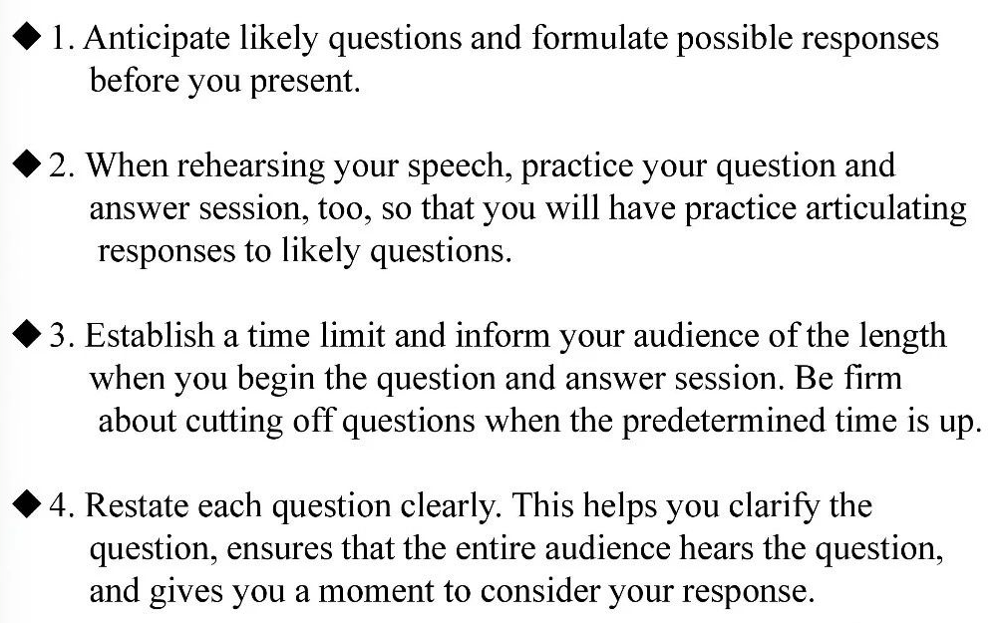
Q&A session

Slide 13
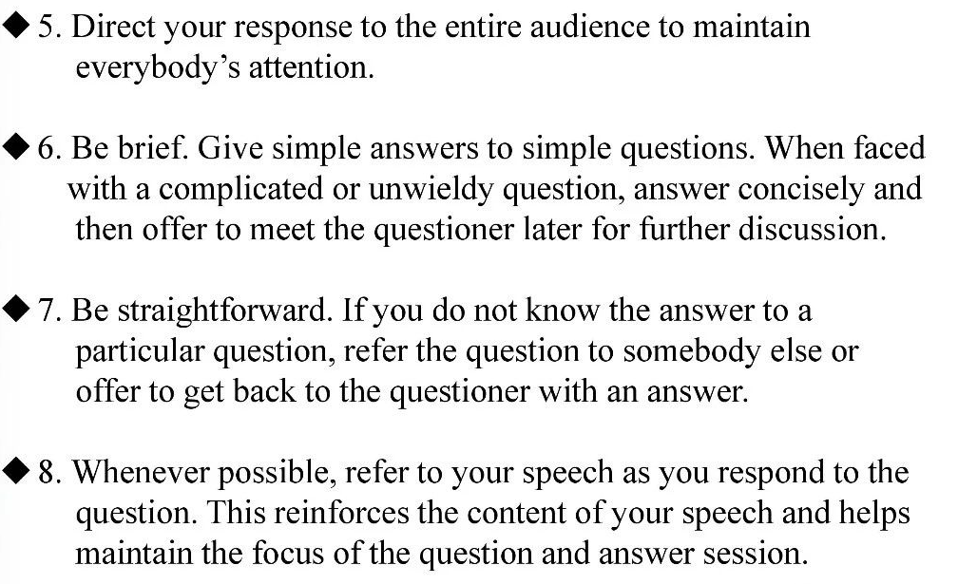

Slide 14
Introducing laboratory
Key elements in a speech introducing a lab
★History
★Location
★Organization
★Research
★Directors
★Achievements (some topics for discussion)
★A general introduction of the lab (big, advanced, world-first-class, newly equipped, spacious and bright, etc.
★When was it founded? (Why was it set up?)
★Compared with what you have today, what was it like at the very beginning? (size, apparatuses, equipment, functions, etc.)
★What kind of experiments can be done here in the lab?
★What kind of important/successful/influential experiments have been done here? And who is in charge of them?
★Are you satisfied with your lab? Why or why not?

Slide 15
Closing speech
At a closing session of an academic conference, the organizer or sponsor would deliver a closing speech, expressing thanks to all the people concerned, summarizing the accomplishments of the conference, commenting on the contributions of the conference, announcing the next conference, extending invitation to the participants and declaring the conference closed.
Paying compliments to the distinguished guests and all the participants
Expressing thanks to the participants, keynote speakers, chairpersons, distinguished guests, etc.
Congratulating on the success of the conference
Summarizing the contents and accomplishments of the conference
Inviting the participants to the next conference announced
Extending best wishes to the participants

Slide 16
Thank You for Attention！

